Slide 1
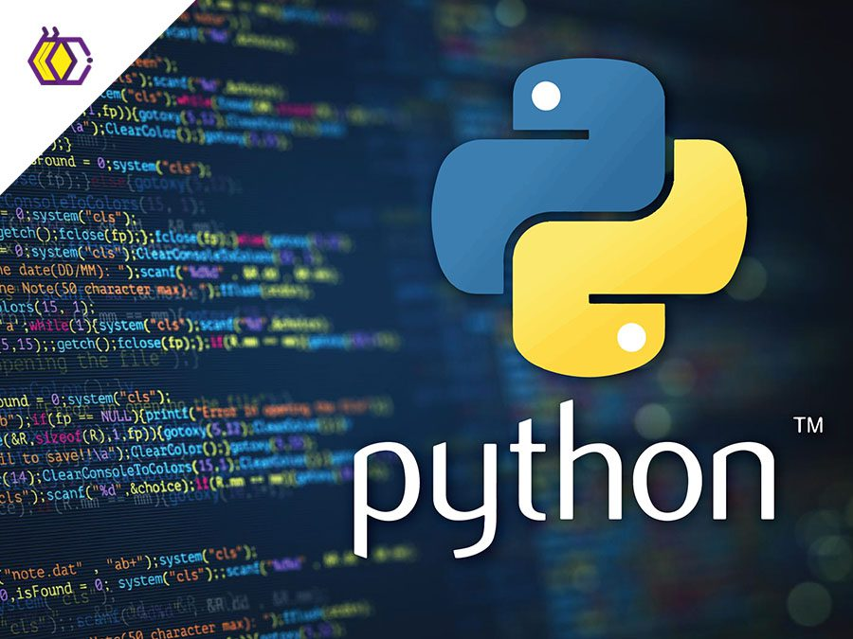
TIWARI PRASHANT DATA SCIENTIST
My presentation is the language of python
PYTHON

Slide 2
Introduction to Python
Python is a high-level, interpreted programming language.
Created by Guido van Rossum in 1991.
Popular for its simplicity and versatility.

Slide 3
Features of Python
1. Easy to learn and use.
2. Open-source and free.
3. Portable and cross-platform.
4. Extensive libraries and frameworks.

Slide 4
Applications of Python
1. Web Development.
2. Data Science and Machine Learning.
3. Scripting and Automation.
4. Game Development.

Slide 5
Python Syntax
1. Indentation defines blocks of code.
2. No need for semicolons or braces.
3. Dynamic typing and simple syntax.

Slide 6
Variables and Data Types
1. Variables are created when assigned a value.
2. Common data types: int, float, str, list, dict, tuple, bool.

Slide 7
Control Structures
1. if-else for decision making.
2. for and while loops for iteration.
3. Functions for code reuse.

Slide 8
Libraries in Python
1. NumPy for numerical computing.
2. Pandas for data manipulation.
3. Matplotlib for visualization.
4. TensorFlow for machine learning.

Slide 9
Object-Oriented Programming
1. Classes and Objects.
2. Inheritance and Polymorphism.
3. Encapsulation.

Slide 10
Conclusion
Python is a versatile language suitable for beginners and professionals.
Its diverse applications make it a valuable skill in the tech industry.

Slide 11
Advantages of Python
1. High productivity and efficiency.
2. Community support and extensive documentation.
3. Integration with other technologies.

Slide 12
THANK YOU
The Goal of This Presentation is to impress, Rather Than information

